Slide 1
Monte Carlo Methods & The Ising Model

Slide 2

Statistical Mechanics
Master equation:
$\frac{dw_{μ}}{dt}= \sum_{ν}{{w_{ν}\left(t\right)R\left(ν→μ\right) −w}_{μ}\left(t\right)R\left(μ→ν\right)}$
Probability Rule:
$\sum_{μ}{w_{μ}\left(t\right)=1}$
Expectation of quantity Q:
$\left\langle Q\right\rangle =\sum_{μ}{Q_{μ}}w_{μ}\left(t\right)$

Slide 3

Equilibrium
Equilibrium occupation probabilities:
$\lim_{t→∞}{w_{μ}\left(t\right)}=p_{μ}$
In thermal equilibrium with reservoir:
$p_{μ}=\frac{1}{Z} e^{−E_{μ}/kT}$
Partition Function:
Z $=\sum_{μ}{e^{−E_{μ}/kT}}=\sum_{μ}{e^{−βE_{μ}}}$ where $β$ = $\frac{1}{kT}$

Slide 4


Important Equations
Expectation of quantity Q:
$\left\langle Q\right\rangle =\sum_{μ}{Q_{μ}}p_{μ}=\frac{1}{Z}\sum_{μ}{Q_{μ}}e^{−βE_{μ}}$
Then the internal energy is:
U$=\frac{1}{Z}\sum_{μ}{E_{μ}e^{−{βE}_{μ}}}$
U$=−\frac{1}{Z}\frac{∂Z}{∂β}$ = $−\frac{∂logZ}{∂β}$
Specific Heat:
C$=\frac{∂U}{∂T}=−kβ^{2}\frac{∂U}{∂β}=kβ^{2}\frac{∂^{2}logZ}{∂β^{2}}$

Slide 5

Energy Fluctuations
We can determine the standard deviation of energy:
$\left\langle E^{2}\right\rangle =\frac{1}{Z}\sum_{μ}{E_{μ}^{2}}e^{−βE_{μ}}=\frac{1}{Z}\frac{∂^{2}Z}{∂β^{2}}$
$\left\langle E^{2}\right\rangle$ - ${\left\langle E\right\rangle }^{2}=\frac{1}{Z}\frac{∂^{2}Z}{∂β^{2}}$ ${−[\frac{1}{Z}\frac{∂Z}{∂β}\text{]}}^{2}$ = $\frac{∂^{2}logZ}{∂β^{2}}$
We note that:
C = $kβ^{2}(\left\langle E^{2}\right\rangle$ - ${\left\langle E\right\rangle }^{2})$

Slide 6
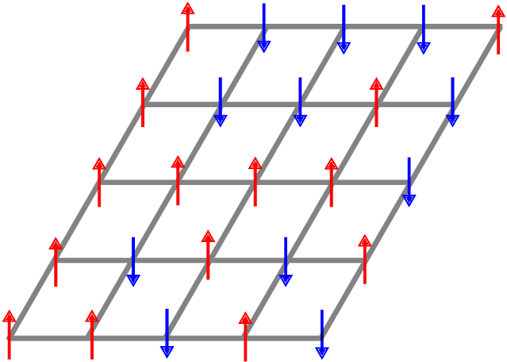

The Ising Model
Hamiltonian:
H = -J$\sum_{\left\langle ij\right\rangle }{s_{i}s_{j}}−B\sum_{i}{s_{i}}$
Partition Function:
Z = $\sum_{\{s_{i}\}}{e^{−βH}}$
Mean Magnetization:
$\left\langle m\right\rangle =\frac{\left\langle M\right\rangle }{N}=$ $\frac{1}{N}$ $\left\langle \sum_{i}{s_{i}}\right\rangle$

Slide 7
Goal of Simulation
Measure various thermodynamic quantities like energy, specific heat, and magnetization at certain temperatures.

Slide 8

Sampling
Instead of choosing M states so each state of system is as likely as the others, we choose states so state $μ$ has probability $p_{μ}=\frac{1}{Z} e^{−E_{μ}/kT}$ of being chosen. Then the estimator is:
$Q_{M}= \frac{1}{M}\sum_{i=1}^{M}{Q_{i}}$
where the summation goes through the selected states
This is done to prevent large inaccuracies in the data

Slide 9

Markov Process
In Monte Carlo simulations, the current state transitions to a new state by some mathematical formalism, called the Markov Process.
These Markov processes make up a Markov Chain of events.
Probability of state going from $μ$ to $ν: P\left(μ→ν\right)$
$\sum_{ν}{P\left(μ→ν\right)}=1$

Slide 10

Condition of Ergodicity
The Markov process should be able to reach any state of the system from any other state, if the simulation is run long enough.
Gives a restriction of selecting $P\left(μ→ν\right)$.

Slide 11

Detailed Balance
To make the simulation “physically reasonable” (satisfying time-reversal symmetry), we make the overall rate of transitions from $μ$ to $ν$ equal to the rate of transitions from $ν$ to $μ$:
$p_{μ}P\left(μ→ν\right)$ = $p_{ν}P\left(ν→μ\right)$
$\frac{P\left(μ→ν\right)}{P\left(ν→μ\right)}$ = $\frac{p_{ν}}{p_{μ}}$ = $e^{−{β(E}_{ν} −E_{μ})}$

Slide 12

Acceptance Ratios
In order to have the flexibility to construct a variety of Markov processes, we set:
$P\left(μ→ν\right)$ =g$\left(μ→ν\right)A\left(μ→ν\right)$
Where g$\left(μ→ν\right)$ is the selection probability, and $A\left(μ→ν\right)$ is the acceptance probability.
$\frac{P\left(μ→ν\right)}{P\left(ν→μ\right)}$ = $\frac{\text{g}\left(μ→ν\right)A\left(μ→ν\right)}{\text{g}\left(ν→μ\right)A\left(ν→μ\right)}$ = $e^{−{β(E}_{ν} −E_{μ})}$

Slide 13
Acceptance Ratios
In order to have the flexibility to construct a variety of Markov processes, we set:
$P\left(μ→ν\right)$ =g$\left(μ→ν\right)A\left(μ→ν\right)$
Where g$\left(μ→ν\right)$ is the selection probability, and $A\left(μ→ν\right)$ is the acceptance probability.
$\frac{P\left(μ→ν\right)}{P\left(ν→μ\right)}$ = $\frac{\text{g}\left(μ→ν\right)A\left(μ→ν\right)}{\text{g}\left(ν→μ\right)A\left(ν→μ\right)}$ = $e^{−{β(E}_{ν} −E_{μ})}$

Slide 14

Metropolis Algorithm
The main requirements of an Ising Model Monte Carlo Algorithm is to satisfy ergodicity and detailed balance.
In the Metropolis Algorithm, all the selection probabilities are the same:
$\text{g}\left(μ→ν\right)=\frac{1}{N}$

Slide 15
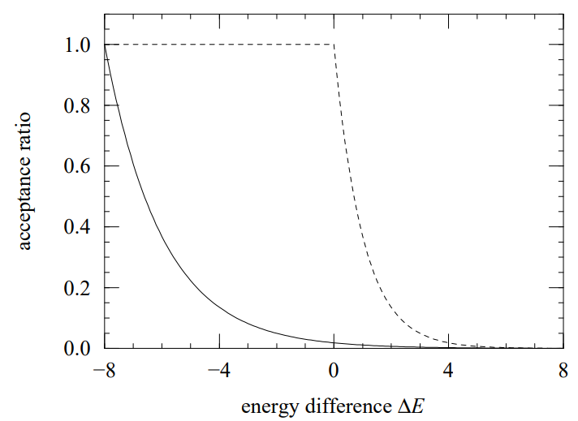


Metropolis Algorithm 2
Detailed Balance:
$\frac{A\left(μ→ν\right)}{A\left(ν→μ\right)}$ = $e^{−{β(E}_{ν} −E_{μ})}$
We want to maximize acceptance ratio:
$A\left(μ→ν\right)$= $\left\{\begin{aligned}e^{−{β(E}_{ν} −E_{μ})} if{ E}_{ν} −E_{μ}>0 \\ 1 otherwise \end{aligned}\right.$
Comparing Metropolis acceptance ratio to:
$A\left(μ→ν\right)$ =$e^{−{β(2zJ+ E}_{ν} −E_{μ})/2}$

Slide 16
Implementing Metropolis
Pick a spin randomly
Flip it with acceptance ratio probability
Repeat N times, where N is number of spins in the model (this is called a sweep)
Repeat a lot of these sweeps until equilibrium is achieved

Slide 17
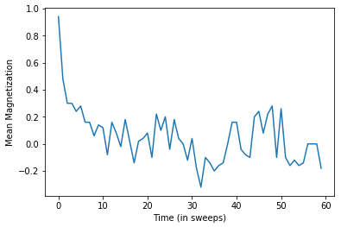
Equilibration
Run simulation for a decently long time (this is for 1.4 K):

Slide 18

Measurement
Consecutive data entries need to be separated by some interval of time to be independent from each other.
This interval of time is known as the correlation time $τ.$

Slide 19

Measurement 2
Time displaced autocorrelation function:
$χ\left(t\right)= \int{dt^{′}[m\left(t^{′}\right)m\left(t^{′}+t\right)−{\left\langle m\right\rangle }^{2}]}$
$χ\left(t\right)$ $\sim e^{−t/τ}$
$τ$ = $\int_{0}^{∞}{e^{−t/τ}dt}=\int_{0}^{∞}{\frac{χ\left(t\right)}{χ\left(0\right)}dt}$

Slide 20
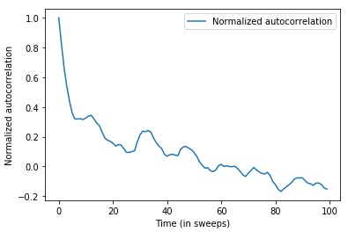
Measurement 3
N =100 spins
T = 1K

Slide 21

Errors
Error of the average of a directly measured quantity Q (e.g., magnetization, energy):
$σ_{Q}= \sqrt{\frac{1}{n−1}(\overline{Q^{2}} −{\overline{Q}}^{2})}$
Bootstrap (for derived quantities like specific heat):
$σ_{c}= \sqrt{ \overline{c^{2}} −{\overline{c}}^{2}}$

Slide 22
Errors
Error of the average of a directly measured quantity Q (e.g., magnetization, energy):
$σ_{Q}= \sqrt{\frac{1}{n−1}(\overline{Q^{2}} −{\overline{Q}}^{2})}$
Bootstrap (for derived quantities like specific heat):
$σ_{c}= \sqrt{ \overline{c^{2}} −{\overline{c}}^{2}}$

Slide 23
Critical Regime
Near T = 2.269K, the critical temperature, the 2D Ising Model undergoes a phase transition.
Below the critical temperature, the system is in the ferromagnetic phase, and a spontaneous magnetization occurs
Above the critical temperature, the thermal energy kT to flip a spin is larger than the spin-spin interaction J, leading to randomly oriented spins

Slide 24

Critical Regime 2
Near the critical temperature, clusters of similarly oriented spins form, which get arbitrarily large in the limit of the critical temperature
$τ\sim ξ^{z}⇒ τ\sim L^{z} where L is length of cluster$. For metropolis, z = 2.17 (experimentally determined)

Slide 25
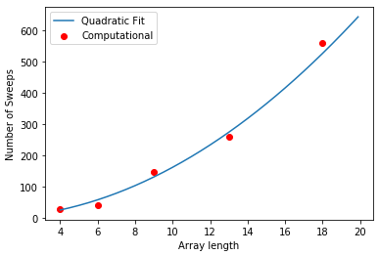

Critical Regime 3
5$×$5 ising array with Metropolis:

Slide 26
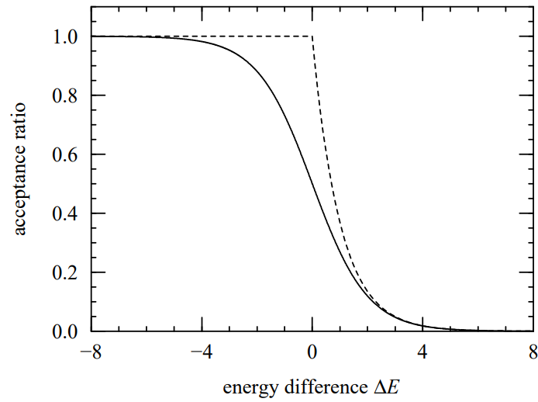

Heat Bath Algorithm
Commonly used for the Potts model (multi-spin magnetic models)
$\text{g}\left(μ→ν\right)=\frac{1}{N}$
$A\left(μ→ν\right)$=$\frac{e^{−βΔE/2}}{e^{−βΔE/2}+e^{βΔE/2}}$ where ${ΔE=E}_{ν} −E_{μ}$

Slide 27
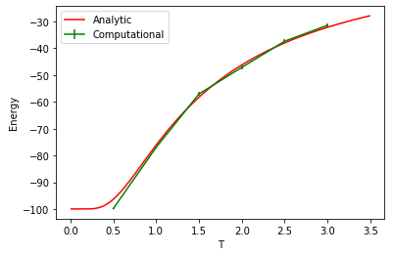
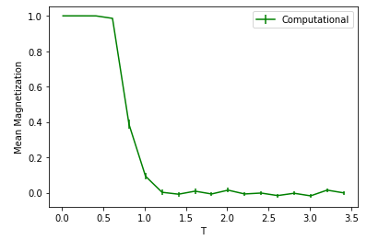
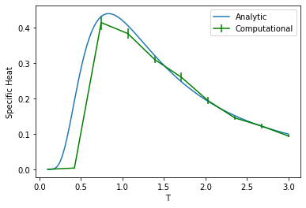
1D Ising with Metropolis
100 spins, measurements taken every 50 sweeps:

Slide 28
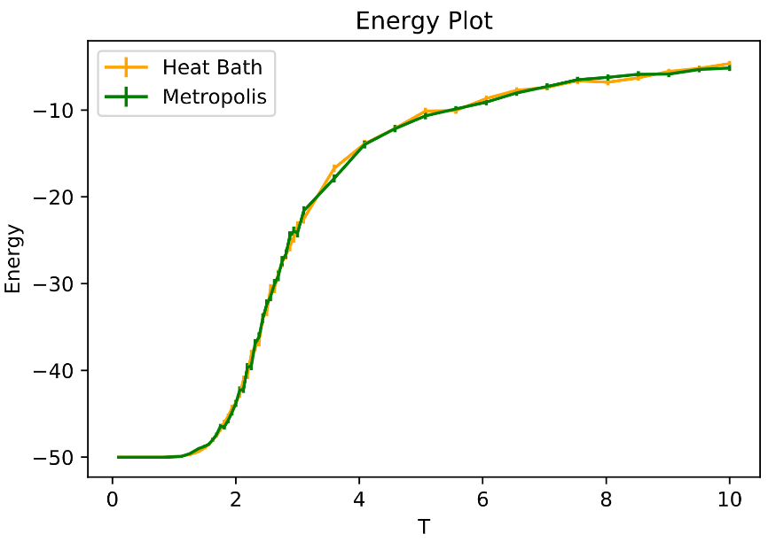
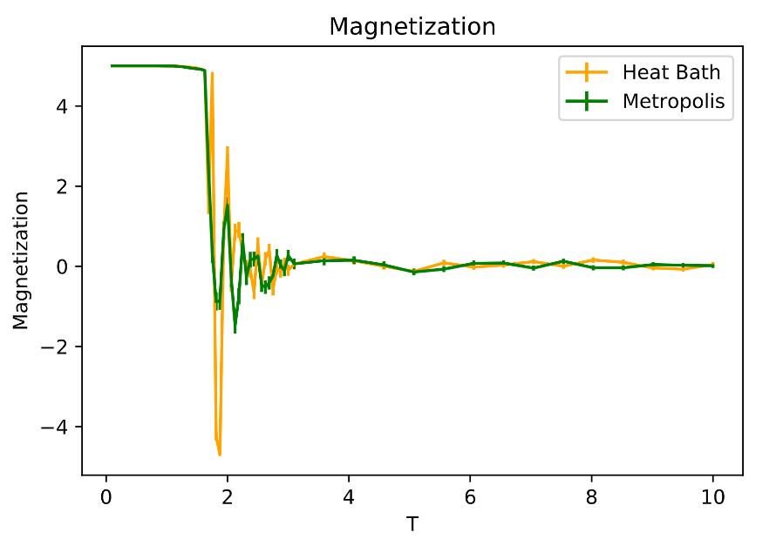
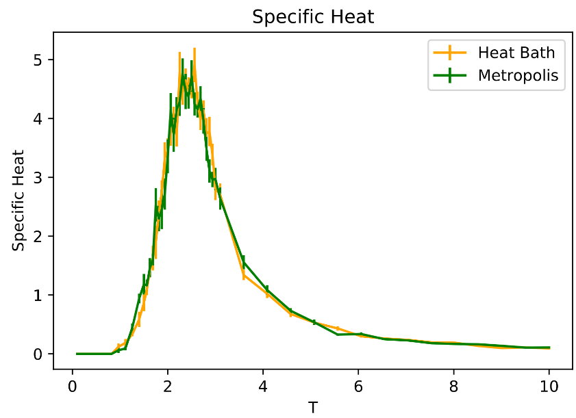
2D Ising with Metropolis, Heat Bath

Slide 29
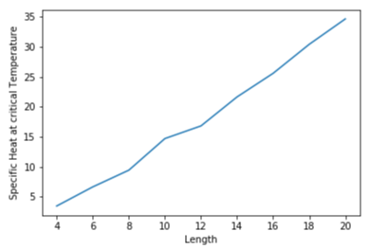
2D Ising Specific Heat Peak with array length

